Slide 1
Probability Based Keys Sharing for IoT
Reut Nager & Sarie Safrin

Slide 2
With the increasing use of them, security breaches have been exploited them to attack sensitive systems.
IoT devices are usually cheap and small, and have weak processing capabilities and few other resources.
Makes it difficult to manage and monitor the state of network security by outside parties and requires internal and independent implementation of security principles.
The problem
Some security application issues with IoT devices

Slide 3

This project focuses on IoT's own local networks rather than those connected to the Internet.

Slide 4
AGREEGMENT ON A COMMON KEY
1. Provide a single key for all devices
2. Handshake between each pair of devices

Slide 5
New security protocol for IoT device network
Sharing keys between the devices on the network in a probability manner, so that there is probably enough overlap between key groups that hold two devices.
This protocol is designed for small networks, and may be used in large networks with hierarchical implementation.
Our Solution
Probability Based Keys Sharing for IoT
5

Slide 6
1
2
Key Pool Size
4
Common-key
STEP 2
STEP 3
STEP 4
STEP 1
STEP 5
3
Send Sub Pool
5
1
Find Master
Secured network
THE PROTOCOL
A new security protocol for the IoT network by a new key management system based on probability key sharing between devices

Slide 7
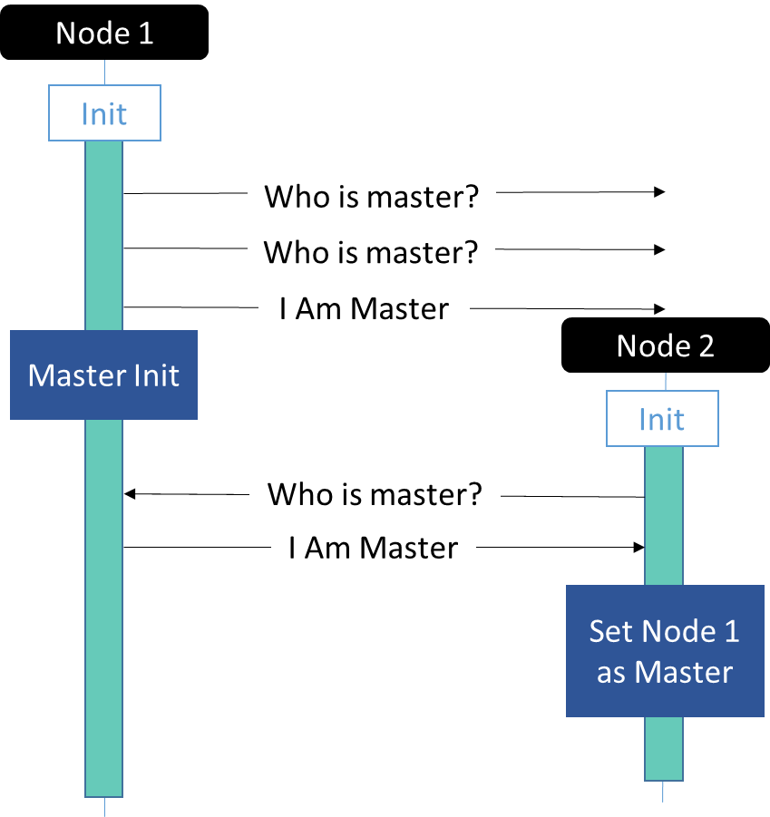
1. Find Master
When node entered to the network, it send twice a broadcast message “IS THERE MASTER”.
If the node don’t get any answer, it set itself to be a master.
When it got a message “IS THERE MASTER”, it will send message “I AM MASTER”.

Slide 8
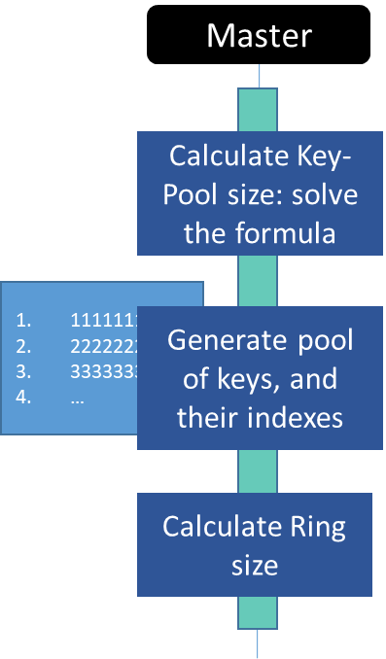
2. Key Pool Size
The master calculates the size of the pool to generate.
The size of the pool depends on the size of the memory, the size of the network, the number of nodes in the neighborhood, the size of the key, the size of the subgroup….
And generate a key pool according to the size calculated

Slide 9
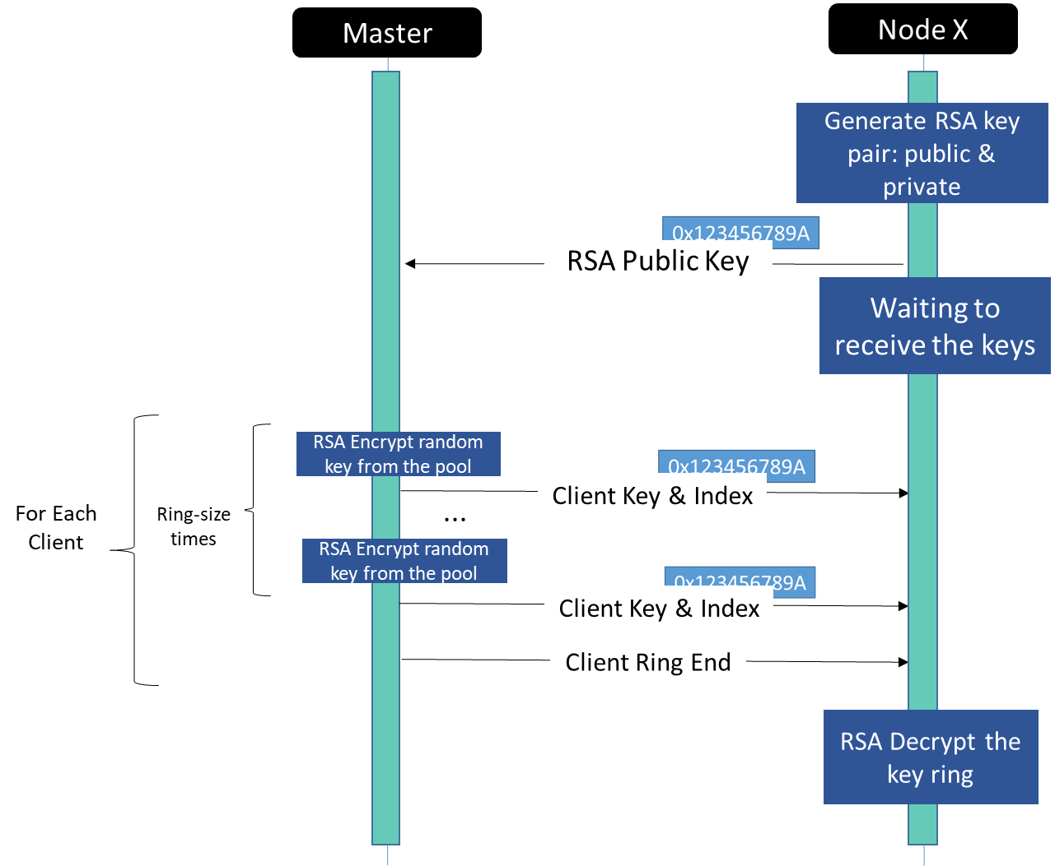
3. Send Sub Pool
Each client creates a public and private RSA key, and sends the public part to the master.
The master random sub-groups of keys from the keys-pool and sends a group to each node that is encrypted with its public key.

Slide 10
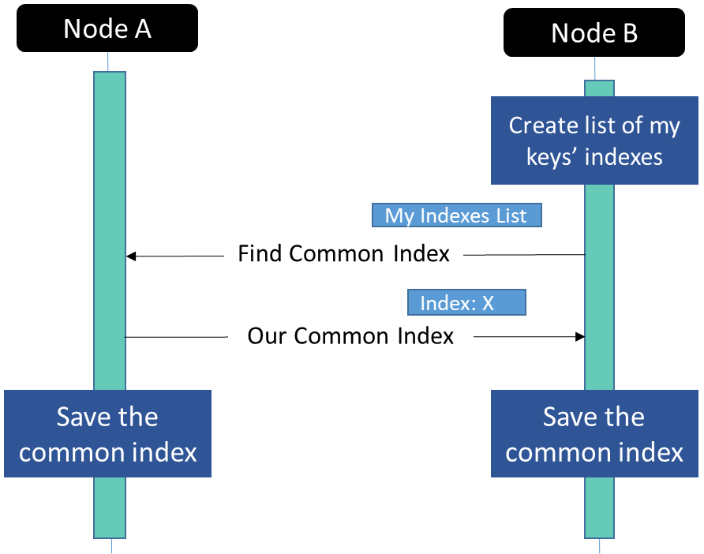
4. Common-key
When node want to send message to other node, he send him its keys indexes.
The node intersection its indexes with the indexes he got from the message, and return the common key.

Slide 11
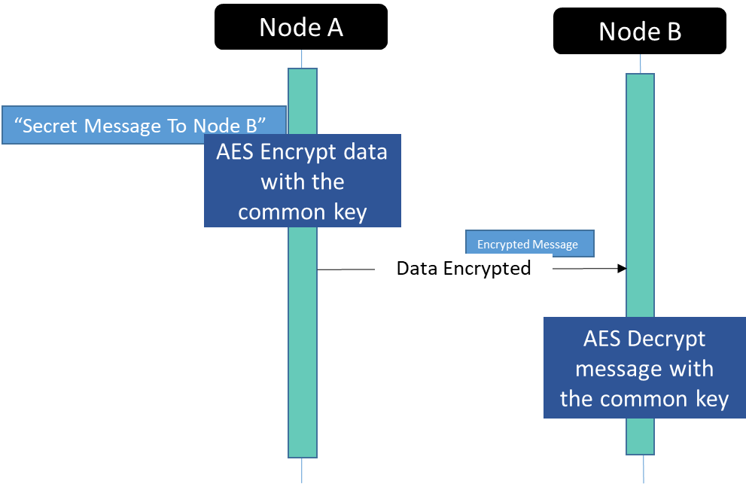
5. Secured Network
Now, the network is secured.
Every node who want to send any message to other node – it encrypt the message with their common key.
Node who left the network don’t detect all the keys.

Slide 12
IMPLEMETATION
COMMUNICATION
STATE
THREADS
Sent in UDP, needed to add a header with size to each message
FORMULA
CRYPTO
Format, re-arrange, variable isolation of the formula.
Variable assignments for different network data.
MESSAGES
DEVICES
Message class, serialization using pickle
During the implementation of the system we encountered many difficulties, some of which are detailed above, until we reached the finished product to that we wished for.

Slide 13
Test program
Math
We ran extensive tests on mathematics and probabilities, intersections , correct formulas.
Tests that the cryptographic functions work as expected, encrypt and decrypt the information as expected.
Cryptography
Unit tests were performed.
Communication
Check that the process works on different IoT devices with different hardware / software.
Compatibility
The code is written in a simple, clear and documented manner.
Maintenance

Slide 14
Conclusions
The software must be compatible with the device it is running on
Emphasis on thought and planning before writing any code
Research project is understanding subjects to their own depth
A thorough search of all available databases
The main thing is not to give up!

Slide 15
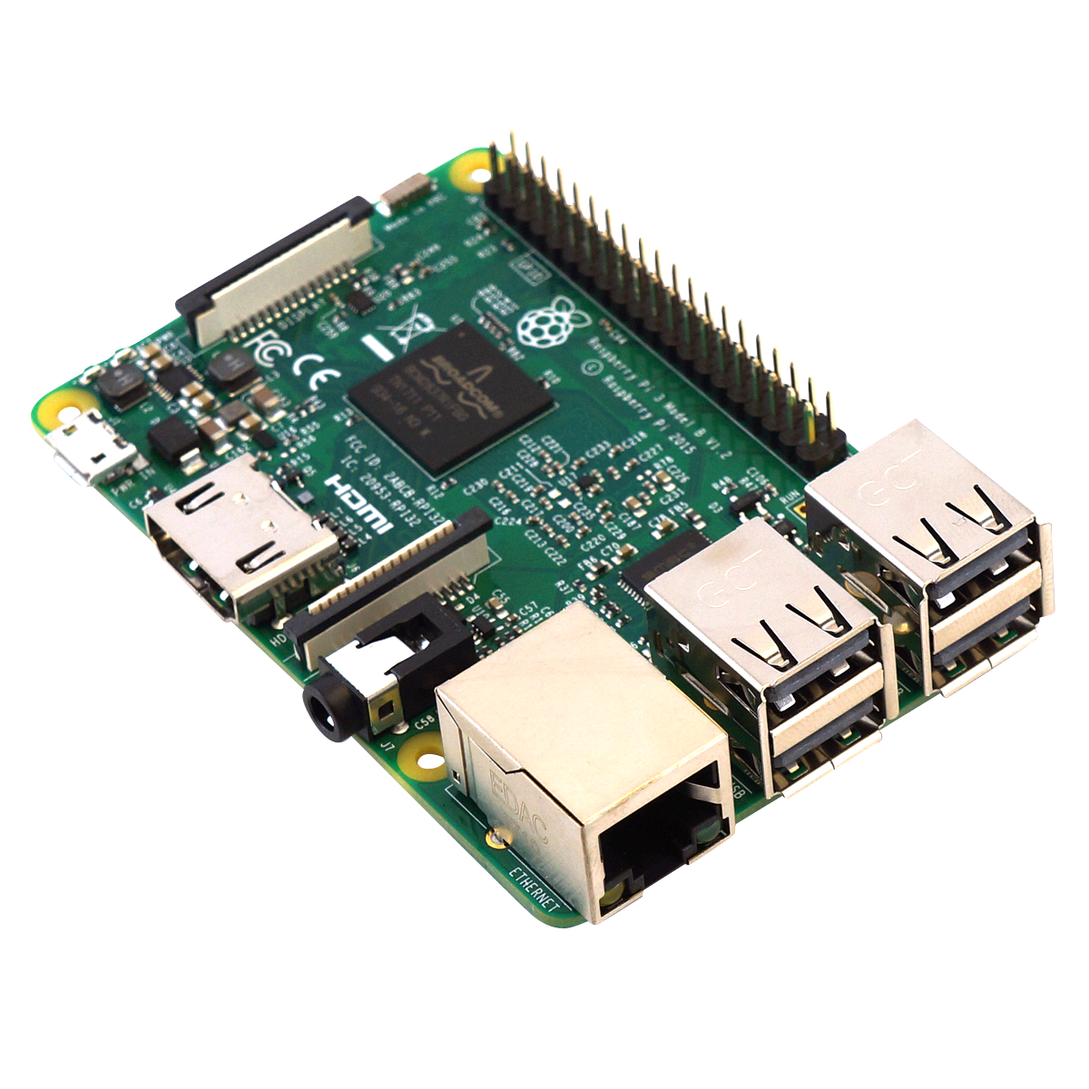
Demo…
We'll see a running demo on three Raspberry Pi 3 devices.
When one will be the master and the other two will be clients

Slide 16
Review similar projects
1
Using a cloud
4
• SDN Architecture
Need to define reliable suppliers for such service
Requires management of cloud service
Solution in case of phishing
2
Using TPM
5
A TPM device is required for each IoT network, an additional cost and communication
3
6
Lack of privacy to set device location and detect new routing for nodes, leading to data loss.

Slide 17
THANK YOU!
ANY QUESTIONS?

